Slide 1
Programming Labwork 1
Pendidikan Teknik Informatika dan Komputer
Universitas Sebelas Maret

Slide 2
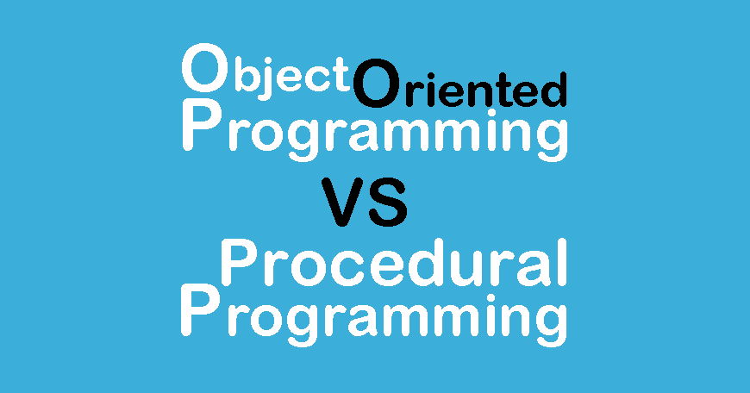

Programming Labwork 2023

Slide 3

Overview
2 Kelas
1 SKS
1 mahasiswa disarankan 1 laptop

Slide 4

Material :
SOLID Principle
Koneksi File dan Database
GUI
Design Pattern
GIT
Projects

Slide 5
Classroom
https://classroom.google.com/
Key: qi5ofyr

Slide 6
Pengalaman Belajar
Memperhatikan
Eksplorasi
1
3
2
Mempelajari
4
Mengembangkan

Slide 7
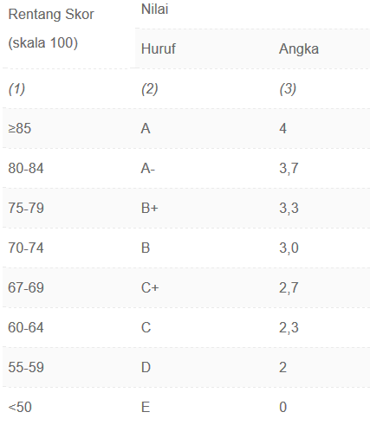
Penilaian
Keaktifan / unjuk kerja (10%)
Tugas (10%)
Responsi (20%)
Project I (30%)
Project II (30%)

Slide 8
Referensi
http://www.tutorialspoint.com/java
http://javabeginnerstutorial.com/core-java
https://docs.oracle.com/javase/tutorial

Slide 9
Thank you.

